Slide 1

DriverPass System Analysis
Allison Hacko
Notes:
[No speaker notes required for this slide.]

Slide 2

System Requirements
Functional Requirements: - The system must allow students to register, log in, and schedule driving lessons online.
The system must allow students to take practice tests and view their test results.
Nonfunctional Requirements:
The system must be secure and protect all user data, including login information and payment details.
The system must be accessible online 24/7 and perform reliably without long wait times or crashes.
Notes:
[In your speaker notes, include an explanation of the different requirements you determined for DriverPass’s system. What are the functional requirements you selected to describe? What are the nonfunctional requirements you selected to describe? Be sure to explain how these requirements meet DriverPass’s needs.]

Slide 3
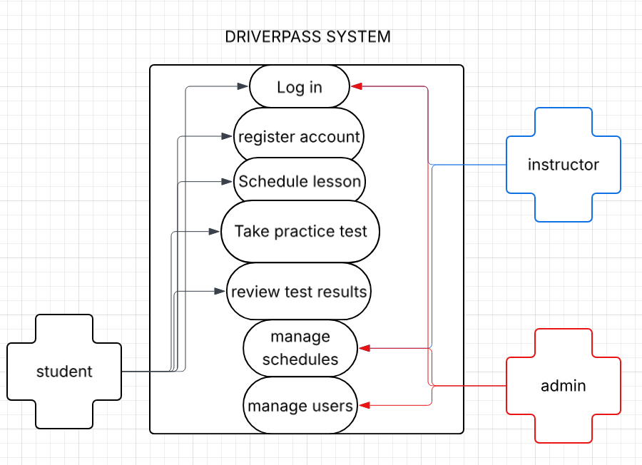
Use Case Diagram
Notes:
[Explain your diagram. Who are the different actors in the system? What are the different use cases? How did you account for DriverPass’s needs in your design? In your explanation, keep your audience in mind. Avoid the use of terms like “actors” and “use cases” in your explanation.]

Slide 4
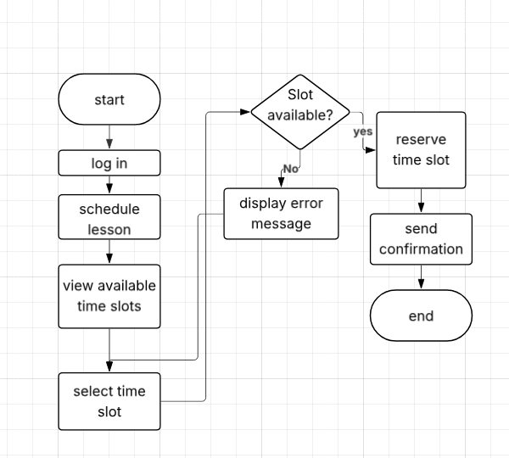
Activity Diagram
[
Notes:
[Explain your diagram. Which use case are you breaking down? What are the steps for this use case? How did you account for DriverPass’s needs in your design? In your explanation, keep your audience in mind. Avoid the use of technical terms such as “nodes,” “control flows,” and so on.]

Slide 5
Security
• User accounts require secure login with encrypted passwords. • The system limits access based on user roles, so students, instructors, and administrators can only see what they are allowed to see. • All personal information, including contact details and payment data, is stored securely. • The system automatically logs users out after inactivity to prevent unauthorized access. • Regular system backups are performed to protect against data loss. • The system uses secure connections to protect information being sent over the internet.
Notes:
[How did you consider security in your design? In your explanation, keep your audience in mind by avoiding the use of technical terms.]

Slide 6
System Limitations
• The system requires a stable internet connection to function properly. • The system does not replace in-person driving instruction; it only supports scheduling and practice testing. • Availability of lessons depends on instructor schedules and may limit booking options. • The system may experience temporary downtime for maintenance or updates. • The system cannot guarantee that all students will pass their driving exam, as performance depends on individual effort.
Notes:
[What are the limitations of your design? In your explanation, keep your audience in mind by avoiding the use of technical terms.]

